Slide 1

Gold Stock Prediction
name :JEYASURIYA J
Batch :MIP-ML-07

Slide 2
Data Collection: Obtain historical gold stock data from a reliable source. You can use APIs like Alpha Vantage or Yahoo Finance, or download CSV files from financial websites. Data Preprocessing: Clean the data, handle missing values, and perform feature engineering if necessary. Split the data into training and testing sets. Model Training: Choose a machine learning model suitable for time series forecasting, such as ARIMA, LSTM, or Prophet. Train the model using the training data. Model Evaluation: Evaluate the trained model's performance using appropriate metrics such as Mean Absolute Error (MAE), Mean Squared Error (MSE), or Root Mean Squared Error (RMSE) on the testing data.
Date | Close | Volume | Open | High | Low
######## | 2029.3 | 166078 | 2027.4 | 2041.9 | 2022.2
######## | 2021.6 | 167013 | 2009.1 | 2025.6 | 2007.7
######## | 2006.5 | 245194 | 2031.7 | 2036.1 | 2004.6
######## | 2030.2 | 277995 | 2053.4 | 2062.8 | 2027.6
######## | 2051.6 | 250946 | 2033.2 | 2067.3 | 2033.1
######## | 2019.2 | 270624 | 2029.4 | 2056.1 | 2017.3
######## | 2027.8 | 183625 | 2036 | 2046.2 | 2025.9
######## | 2033 | 194610 | 2034.5 | 2048.6 | 2031.9
######## | 2033.5 | 199325 | 2052.6 | 2053.3 | 2022.7
######## | 2049.8 | 208861 | 2051.4 | 2071.1 | 2030.8
######## | 2050 | 125573 | 2049.3 | 2058.1 | 2043.3

Slide 3
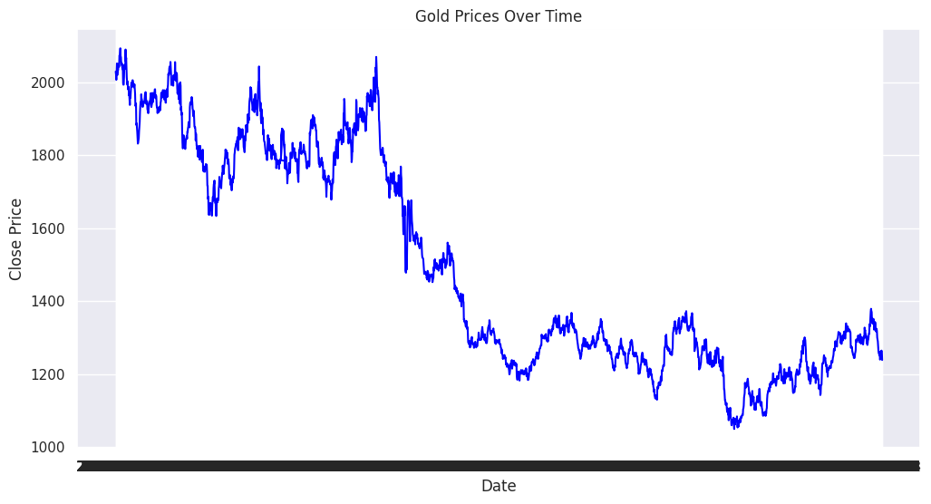
Closing price of the gold stock

Slide 4

Predicted Values of Gold Stock
Date | Predicted_Close
0 | 2024-01-19 | 1059.694
1 | 2024-01-20 | 1059.694
2 | 2024-01-21 | 1059.694
3 | 2024-01-22 | 1059.694
Conclusion:
Provide a concise conclusion summarizing the key findings and insights derived from the analysis.
Discuss the significance of the findings in the context of the broader domain of financial markets or gold trading.

